Slide 1

ECE 298 PRESENTATION
HOME SECURITY SYSTEM
By: Michael Meng, Matthew Tang

Slide 2
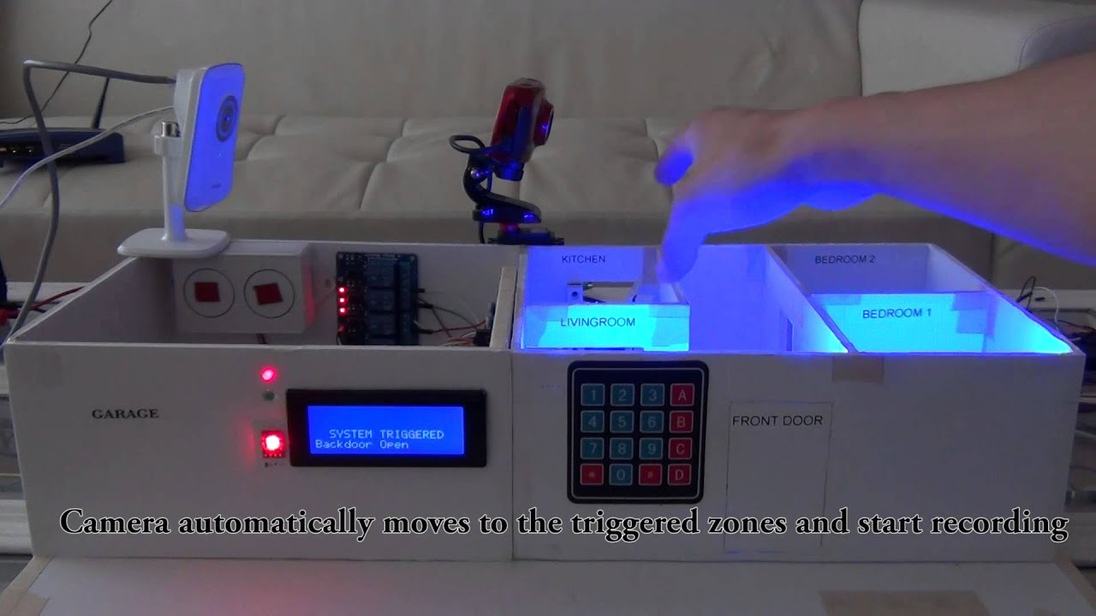
Original Concept, Design Goals, and Results
(Taking Home Security to The Next Level)
Goals:
1. Monitor 4 Zones Using Sensors
2. Sound Sensor With Software & Hardware Filtering
3. GUI For Sending Shell Commands Using UART for Zone Controls
4. Display Zone Statuses on LCD and LED
Figure 1: Our initial vision of the final project

Slide 3
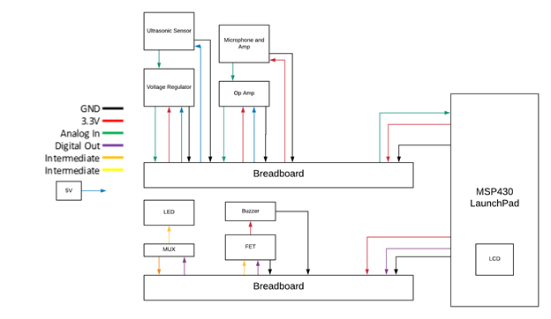
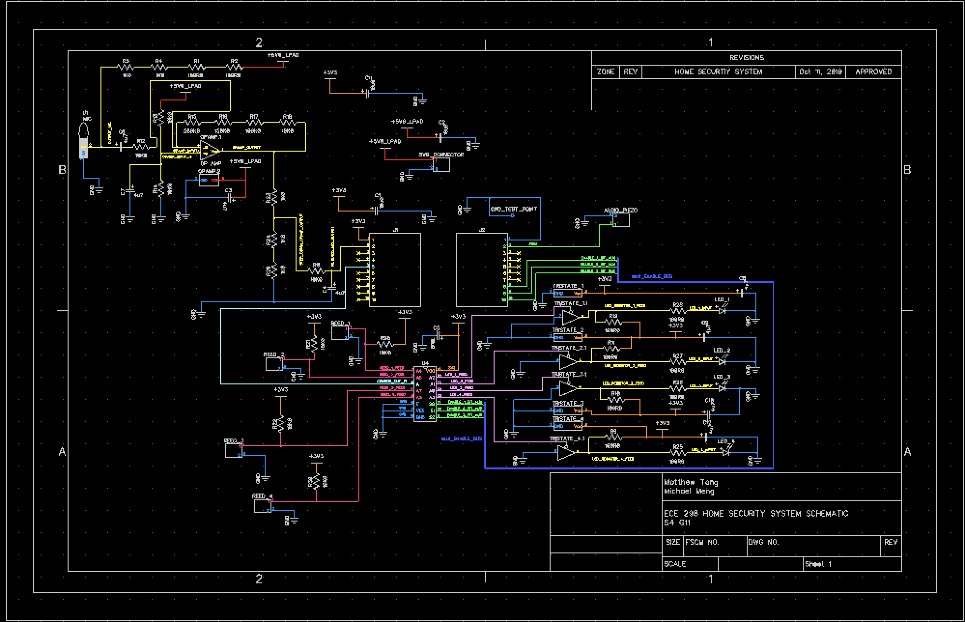
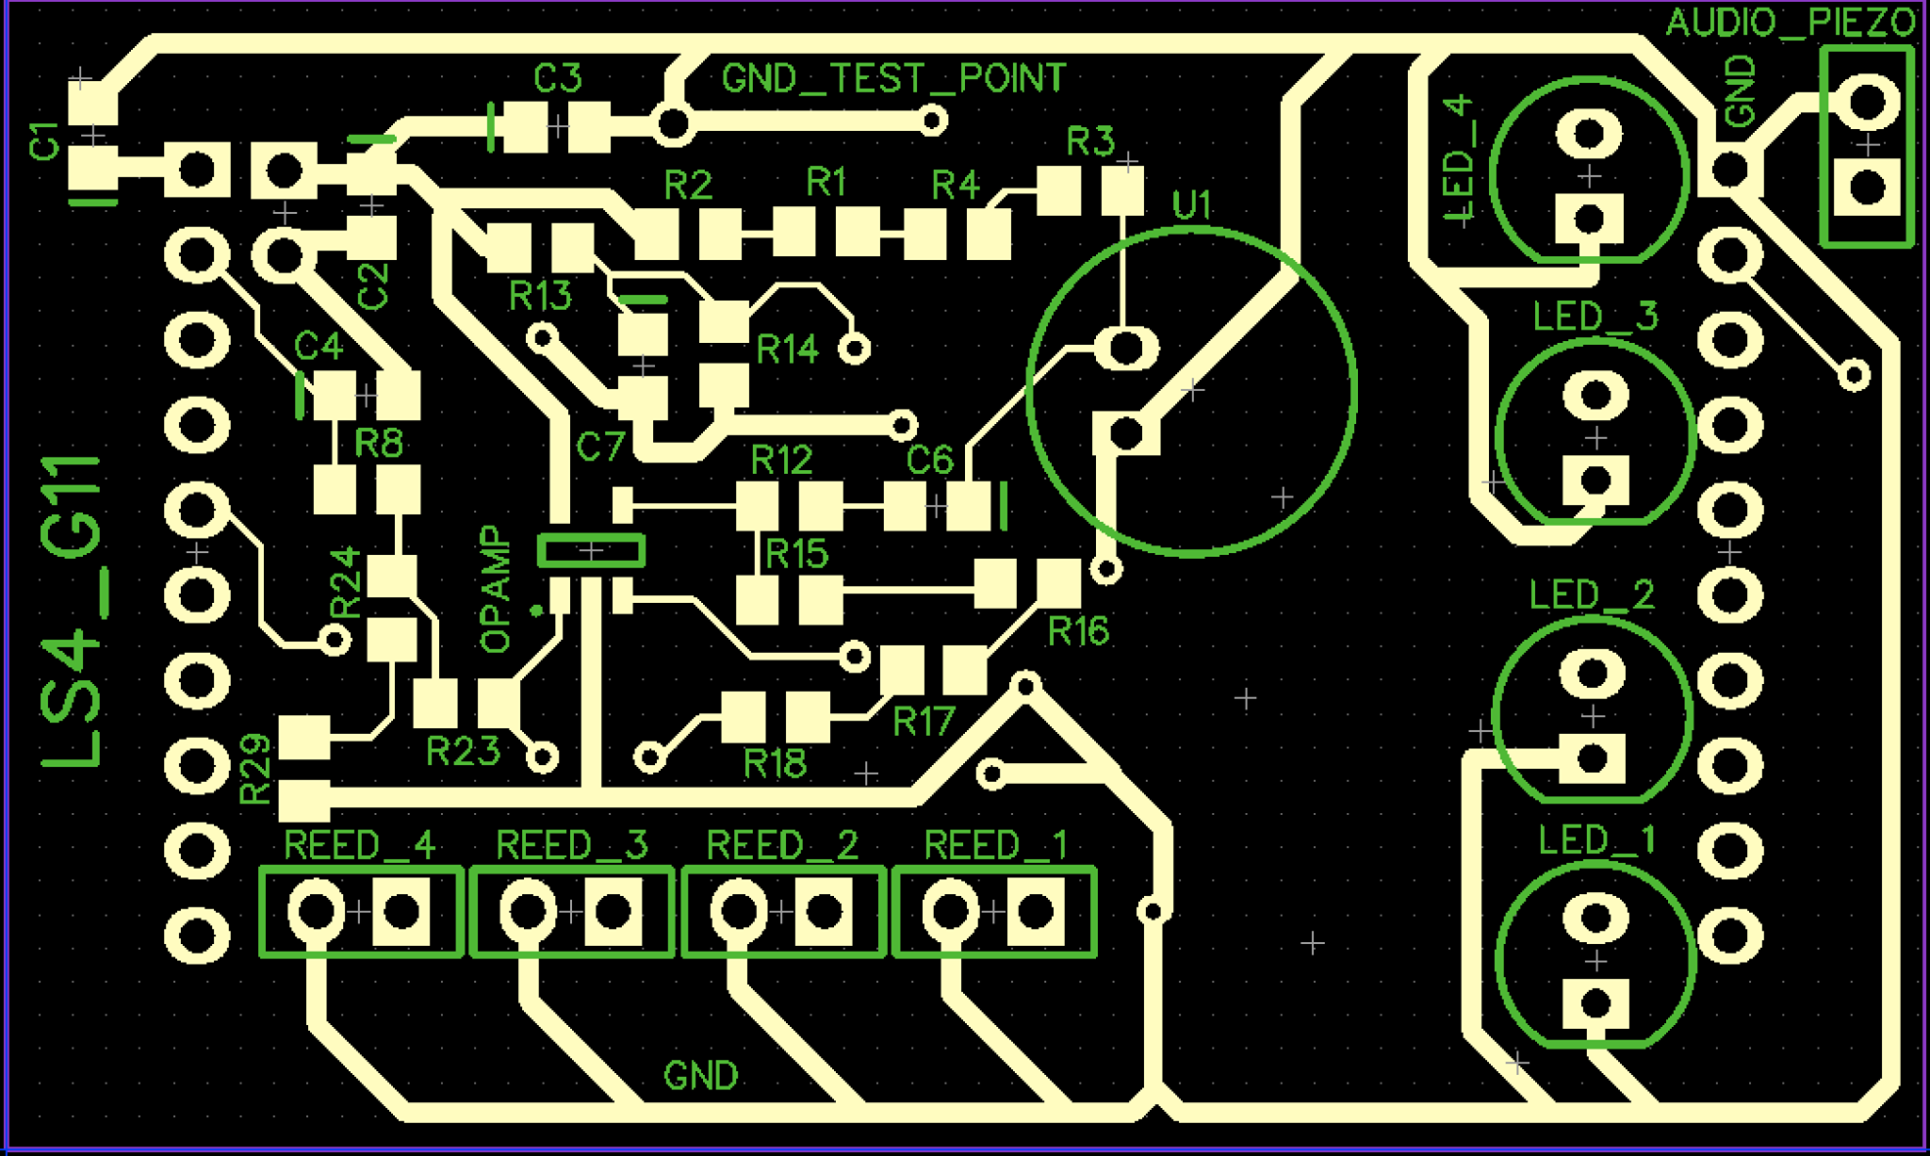
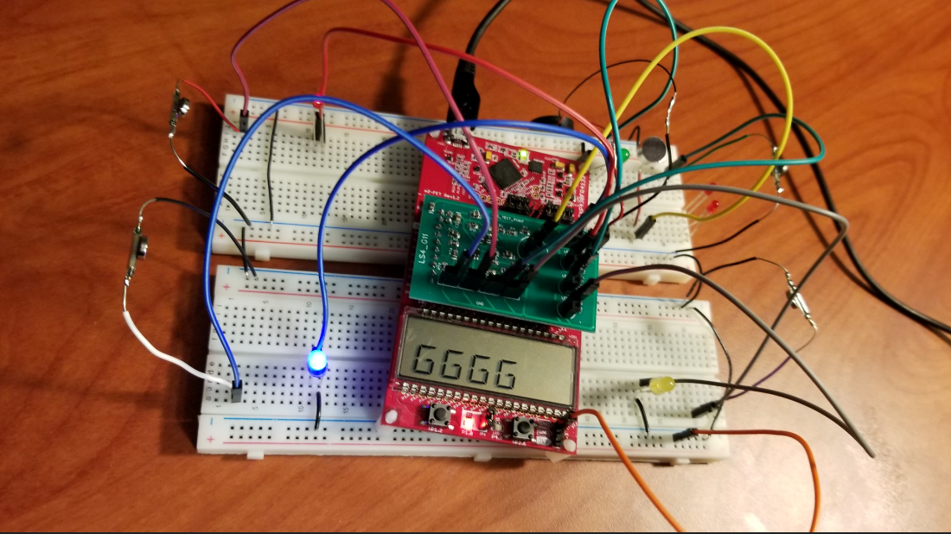
Week 1-4
Week 5-7
Week 8-9
Week 10-12
Feasibility Model
Schematic Design
PCB Design
Final Assembly
Construct and Debug BreadBoard System
Designed, Refined, and Modified Original System Into a Schematic Layout
Modified and Edited Schematic to Create Final PCB Design
Constructed Final Prototype

Slide 4
Progression -> Feasibility Model
4 Ultrasonic Sensors (Step Down Echo-Out Pin Feeding Into GPIO Pin)
Use Microphone For Sound Detection
Low Pass Filter for Sound Filtering
Piezo Buzzer For Intruder Indication
LED For Zone Intruder Indication From Sound or Ultrasonic Sensor
LCD for Displaying RTC and Zone Arm/Disarm state
Figure 2: Feasibility Diagram

Slide 5
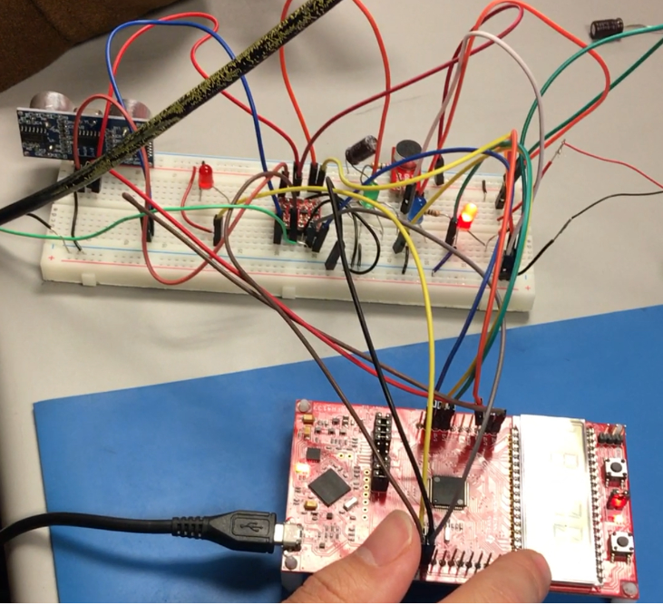
Figure 3: Breadboard System with UltraSonic Sensor, Mic Sensor, LCD Display

Slide 6
Progression -> Prototype -> Schematic
Microphone Op Amp Filtering Circuit (Includes Passive Low Pass Filter Circuit For Sound Filtering)
Multiplexer
Reed Switch Circuit
LED circuit, With Tristate Buffers
Piezo Electric Buzzer
5
1
4
3
2
Figure 4: Completed Schematic Circuit With Labels

Slide 7
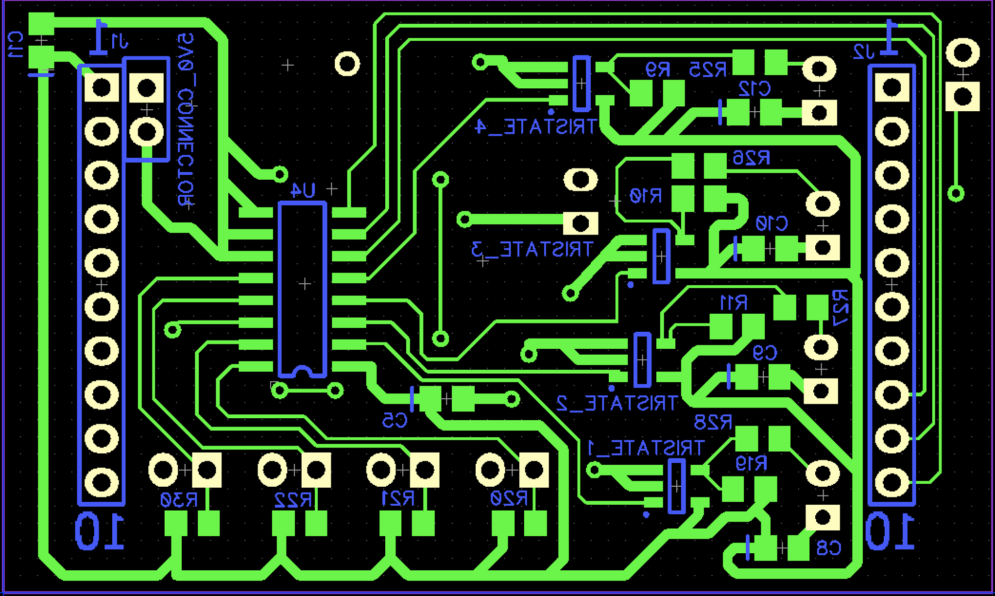
Progression -> Prototype -> PCB Layout
5
Microphone Op Amp Filtering Circuit (Includes Passive Low Pass Filter Circuit for Sound Filtering)
Multiplexer
Reed Switch Circuit
LED Circuit, With Tristate Buffers
Piezo Electric Buzzer
1
3
2
4
2
4
Figure 5: PCB Design With Labels

Slide 8
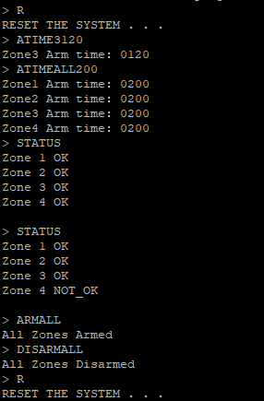
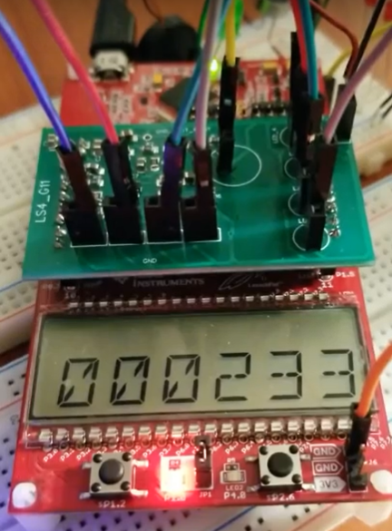
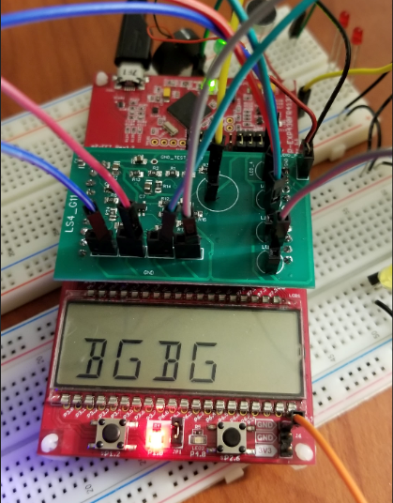
Progression -> Prototype -> Software
UART to USB RTC ZONE Monitoring
Figure 6: UART Interface to Send Commands to MCU
Figure 7: Real Time Display on LCD
Figure 8: LED Display For Armed/Disarmed Zones

Slide 9
Progression -> Prototype -> DEMO
Figure 9: Top View of Project
Figure 10: UART Command Interface

Slide 10
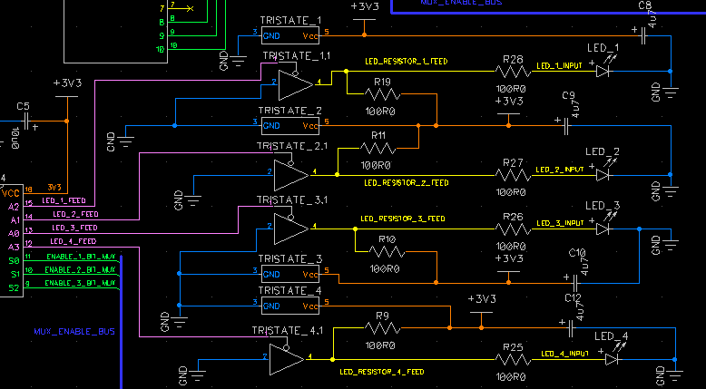
Progression -> Prototype -> LED Circuit
Figure 11: LED Circuit Connected to the Multiplexor Output

Slide 11

Progressions -> Production Ready Model Next Steps
01
Hardware
For the tristate circuit, our power supply was going through capacitors, and this caused some issues with trying to individually turn on or off individual LED’s, as current discharge was occurring.
Needs more test points, to test components on the back of PCB
Could remove tristate buffers, and have direct connection from MUX to LED, save money and space on PCB
02
Improve software filtering for MIC
Create CLI for UART to USB shell control
Software

Slide 12
Group Reflection
01
Embedded C Software Development and Debugging
UART Protocol
Circuit Design and Debugging
PCB Design
Soldering
Diptrace and Code Composer
What new skills did you develop?
02
Mistakes happen, do not be discouraged
Review Schematic and PCB Design Thoroughly to Prevent Simple Circuit Logic Errors
Don’t Rush, Take Your Time To Think, Debug, and Solve any Problems You Face
What insights did you gain into the development process?
03
Shortage of Parts -> Place and Pick Up Order Faster, Read DataSheet before Using Modules
Time Management -> Dedicate ~3 Hours Weekly to Distribute the Workload Instead of Cramming At The End
LED Display Not Working With Tristate -> Drive LED With Mux Without Using Tristate Buffers and Passive Pull Ups
Very Few Test Points -> Add More Test Points
Inconsistent Mic Filtering -> Improve Software Filtering for Mic
What roadblocks did you face and what would you do differently next time?

Slide 13
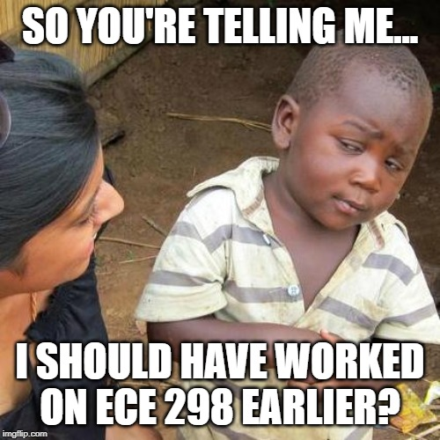


Notes to Future ECE 298 Students
Time Management is Key
Don’t Give Up, Think Through the Problems
Have Fun!

Slide 14
